Slide 1

Validation, Verification and Testing
Photocopiable/digital resources may only be copied by the purchasing institution on a single site and for their own use
© ZigZag Education, 2021
Notes:
8282679

Slide 2
Validation
Validation enables programs to check that data entered meets certain rules.
Types of validation include:
Range Checks
Length Checks
Type Checks
Check Digits
© ZigZag Education, 2021

Slide 3
Range Checks
Range checks are used to test whether a value is within a specified range.
This example pseudocode checks whether the mark entered is in the range 0 to 25.
Mark ← INPUT
IF Mark >= 0 AND Mark <= 25
THEN
OUTPUT "Mark valid"
ELSE
OUTPUT "Mark out of range"
ENDIF
Input | 5
Output | “Mark Valid”
© ZigZag Education, 2021

Slide 4
Length Checks
Length checks are used to test whether the value entered is of a specified length.
This example pseudocode checks whether the password entered is at least 5 characters in length.
Password ← INPUT
IF LEN(Password) < 6
THEN
OUTPUT "Password too short"
ELSE
OUTPUT "Password valid"
ENDIF
Input | “Hello”
Output | “Password too short”
© ZigZag Education, 2021

Slide 5
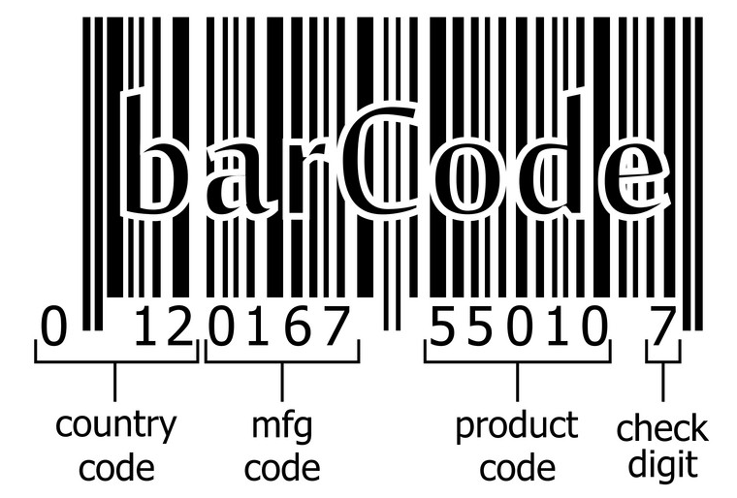
Type Checks and Check Digits
Type checks test the inputted data to ensure it matches the required data type. For example, a score might be checked to make sure it is an integer.
A check digit is a digit added to the end of an identification number that is used to test whether the number has been entered correctly.
Check digits are widely used in product barcodes.
© ZigZag Education, 2021

Slide 6
Test Data
It is important to test the validation that we build into our programs to ensure it works as we expect it to.
There are three types of test data that it is standard to use when testing algorithms and programs.
Normal
Boundary
Erroneous
Data that is well within the normal range of what should be accepted.
Data that is at the upper or lower range of what should be accepted.
Data that is invalid and should not be accepted.
Sometimes data can be both boundary and erroneous if it is just outside the range of what should be accepted.
© ZigZag Education, 2021

Slide 7
Test Table Example
Mark ← INPUT
IF Mark >= 0 AND Mark <= 25
THEN
OUTPUT "Mark valid"
ELSE
OUTPUT "Mark out of range"
ENDIF
10
30
25
Description | Test Type | Test Data | Expected Outcome | Result
Test the highest allowable integer | Boundary | 25 | ‘Mark valid’ | ‘Mark valid’
Test value higher than allowable range | Erroneous | 30 | ‘Mark out of range’ | ‘Mark out of range’
Test Value within allowable range | Normal | 10 | ‘Mark valid’ | ‘Mark valid’
© ZigZag Education, 2021

Slide 8
Verification
Verification checks user input by asking the user to input the same data more than once to verify it is correct.
The pseudocode below verifies the password the user has entered.
Password ← INPUT
PasswordVerify ← INPUT
IF Password = PasswordVerify
THEN
OUTPUT "Passwords match"
ELSE
OUTPUT "Password do not match"
ENDIF
© ZigZag Education, 2021

Slide 9
END

